Slide 1
Access Control Lists

Slide 2
Introduction to Access Control Lists
What is an ACL?
An ACL is a series of IOS commands that are used to filter packets based on information found in the
packet header.
Task | Example
Limit network traffic to increase network performance | A corporate policy prohibits video traffic on the network to reduce the network load. A policy can be enforced using ACLs to block video traffic.
Provide traffic flow control | A corporate policy requires that routing protocol traffic be limited to certain links only. A policy can be implemented using ACLs to restrict the delivery of routing updates to only those that come from a known source.
Provide a basic level of security for network access | Corporate policy demands that access to the Human Resources network be restricted to authorized users only. A policy can be enforced using ACLs to limit access to specified networks.
Filter traffic based on traffic type | Corporate policy requires that email traffic be permitted into a network, but that Telnet access be denied. A policy can be implemented using ACLs to filter traffic by type.
Screen hosts to permit or deny access to network services | Corporate policy requires that access to some file types (e.g., FTP or HTTP) be limited to user groups. A policy can be implemented using ACLs to filter user access to services.
Provide priority to certain classes of network traffic | Corporate traffic specifies that voice traffic be forwarded as fast as possible to avoid any interruption. A policy can be implemented using ACLs and QoS services to identify voice traffic and process it immediately.

Slide 3
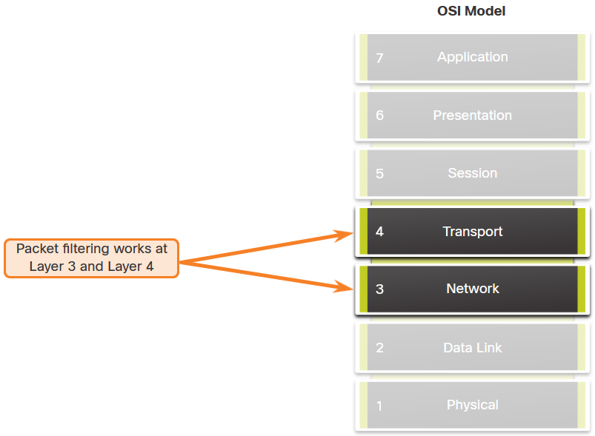
Introduction to Access Control Lists
Packet Filtering
Packet filtering controls access to a network by analyzing the incoming and/or outgoing packets and forwarding them or discarding them based on given criteria. Packet filtering can occur at Layer 3 or Layer 4. Cisco routers support standard and extended ACLs.

Slide 4
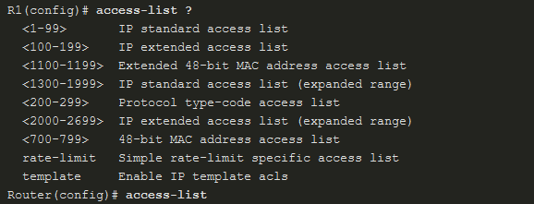

Introduction to Access Control Lists
Numbered and Named ACLs
Numbered ACLs - ACLs number 1 to 99, or 1300 to 1999 are standard ACLs while ACLs number 100 to 199, or 2000 to 2699 are extended ACLs, as shown in the output.
Named ACLs - Named ACLs is the preferred method to use when configuring ACLs. Specifically, standard and extended ACLs can be named to provide information about the purpose of the ACL. The ip access-list global configuration command is used to create a named ACL.

Slide 5
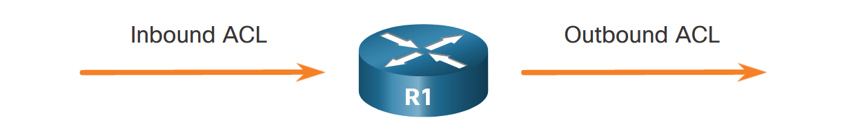
Introduction to Access Control Lists
ACL Operation
ACLs define the set of rules that give added control for packets that enter inbound interfaces, packets that relay through the router, and packets that exit outbound interfaces of the router.
An inbound ACL filters packets before they are routed to the outbound interface. If the packet is permitted by the ACL, it is then processed for routing. Inbound ACLs are best used to filter packets when the network attached to an inbound interface is the only source of packets that need to be examined.
An outbound ACL filters packets after being routed, regardless of the inbound interface. Incoming packets are routed to the outbound interface and then they are processed through the outbound ACL. Outbound ACLs are best used when the same filter will be applied to packets coming from multiple inbound interfaces before exiting the same outbound interface.

Slide 6
Wildcard Masking

Slide 7
Wildcard Masking
Wildcard Mask Overview
A wildcard mask is like a subnet mask in that it uses the ANDing process to identify which bits in an IPv4 address to match. However, they differ in the way they match binary 1s and 0s. Unlike a subnet mask, in which binary 1 is equal to a match and binary 0 is not a match, in a wildcard mask, the reverse is true.
Wildcard Mask | Last Octet (in Binary) | Meaning (0 - match, 1 - ignore)
0.0.0.0 | 00000000 | Match all octets.
0.0.0.63 | 00111111 | Match the first three octets Match the two left most bits of the last octet Ignore the last 6 bits
0.0.0.15 | 00001111 | Match the first three octets Match the four left most bits of the last octet Ignore the last 4 bits of the last octet
0.0.0.252 | 11111100 | Match the first three octets Ignore the six left most bits of the last octet Match the last two bits
0.0.0.255 | 11111111 | Match the first three octet Ignore the last octet

Slide 8
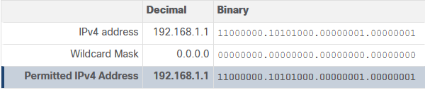
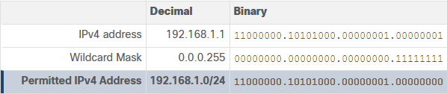
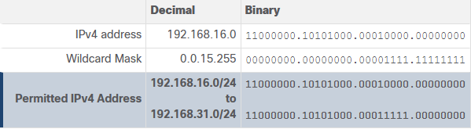
Wildcard Masking
Wildcard Mask Types
Wildcard Mask to Match a Host
Wildcard Mask to Match an IPv4 Subnet
Wildcard Mask to Match an IPv4 Address Range

Slide 9
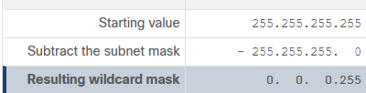
Wildcard Masking
Wildcard Mask Calculation
Calculating wildcard masks can be challenging. One shortcut method is to subtract the subnet mask from 255.255.255.255.
Assume you wanted an ACE in ACL 10 to permit access to all users in the 192.168.3.0/24 network. To calculate the wildcard mask, subtract the subnet mask (i.e., 255.255.255.0) from 255.255.255.255, as shown in the table.
The solution produces the wildcard mask 0.0.0.255. Therefore, the ACE would be access-list 10 permit 192.168.3.0 0.0.0.255.

Slide 10

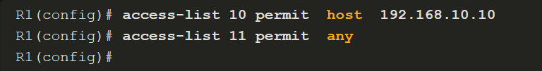
Wildcard Masking
Wildcard Mask Keywords
Keywords reduce ACL keystrokes and make it easier to read the ACE:
host - This keyword substitutes for the 0.0.0.0 mask. This mask states that all IPv4 address bits must match to filter just one host address.
any - This keyword substitutes for the 255.255.255.255 mask. This mask says to ignore the entire IPv4 address or to accept any addresses.
For example, these ACL commands…
…can be rewritten as follows:

Slide 11
Configure ACLs

Slide 12
Configure ACLs
Numbered Standard IPv4 ACL Syntax
To create a numbered standard ACL, use the following global configuration command:
Use the no access-list access-list-number global configuration command to remove a numbered standard ACL.

Slide 13
Configure ACLs
Numbered Standard IPv4 ACL Syntax (Cont.)
This table provides a detailed explanation of the syntax for a standard ACL.
Parameter | Description
access-list-number | This is the decimal number of the ACL. Standard ACL number range is 1 to 99 or 1300 to 1999.
deny | This denies access if the condition is matched.
permit | This permits access if the condition is matched.
remark text | (Optional) This adds a text entry for documentation purposes. Each remark is limited to 100 characters.
source | This identifies the source network or host address to filter. Use the any keyword to specify all networks. Use the host ip-address keyword or simply enter an ip-address (without the host keyword) to identify a specific IP address.
source-wildcard | (Optional) This is a 32-bit wildcard mask that is applied to the . If omitted, a default 0.0.0.0 mask is assumed.
log | (Optional) This keyword generates and sends an informational message whenever the ACE is matched. Message includes ACL number, matched condition (i.e., permitted or denied), source address, and number of packets.{`{" "}`} This message is generated for the first matched packet. This keyword should only be implemented for troubleshooting or security reasons.

Slide 14
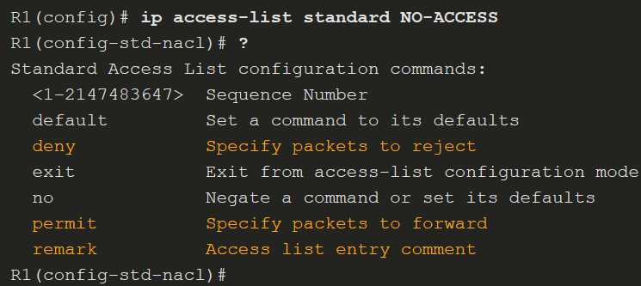
Configure ACLs
Named Standard IPv4 ACL Syntax
ACL names are alphanumeric, case sensitive, and must be unique. Capitalizing ACL names is recommended. To create a named standard ACL, use the following global configuration command:
In the example, a named standard IPv4 ACL called NO-ACCESS is created. Notice that the prompt changes to named standard ACL configuration mode. Use the help facility to view all the named standard ACL ACE options.

Slide 15
Configure ACLs
Numbered Extended IPv4 ACL Syntax
The procedural steps for configuring extended ACLs are the same as for standard ACLs. The extended ACL is first configured, and then it is activated on an interface. However, the command syntax and parameters are more complex to support the additional features provided by extended ACLs.
To create a numbered extended ACL, use the following global configuration command:
The parameters are reviewed on the next two slides.
The command to apply an extended IPv4 ACL to an interface is the same as the command used for standard IPv4 ACLs.

Slide 16
Configure ACLs
Numbered Extended IPv4 ACL Syntax (Cont.)
Although there are many keywords and parameters for extended ACLs, it is not necessary to use all of them when configuring an extended ACL. The table provides a detailed explanation of the syntax for an extended ACL.
Parameter | Description
access-list-number | This is the decimal number of the ACL. Extended ACL number range is 100 to 199 and 2000 to 2699.
deny | This denies access if the condition is matched.
permit | This permits access if the condition is matched.
remark text | (Optional) Adds a text entry for documentation purposes. Each remark is limited to 100 characters.
protocol | Name or number of an internet protocol. Common keywords include ip, tcp, udp, and icmp. The ip keyword matches all IP protocols.
source | This identifies the source network or host address to filter. Use the any keyword to specify all networks. Use the host ip-address keyword or simply enter an ip-address (without the host keyword) to identify a specific IP address.
source-wildcard | (Optional) A 32-bit wildcard mask that is applied to the source.
(table continued on next slide)

Slide 17
Configure ACLs
Numbered Extended IPv4 ACL Syntax (Cont.)
Parameter | Description
destination | This identifies the destination network or host address to filter. Use the any keyword to specify all networks. Use the host ip-address keyword or ip-address.
destination-wildcard | (Optional) This is a 32-bit wildcard mask that is applied to the destination.
operator | (Optional) This compares source or destination ports. Some operators include lt (less than), gt (greater than), eq (equal), and neq (not equal).
port | (Optional) The decimal number or name of a TCP or UDP port.
established | (Optional) For the TCP protocol only. This is a 1st generation firewall feature.
log | (Optional) This keyword generates and sends an informational message whenever the ACE is matched. This message includes ACL number, matched condition (i.e., permitted or denied), source address, and number of packets. This message is generated for the first matched packet. This keyword should only be implemented for troubleshooting or security reasons.

Slide 18
Configure ACLs
Named Extended IPv4 ACL Syntax
Naming an ACL makes it easier to understand its function. This command enters the named extended configuration mode. Recall that ACL names are alphanumeric, case sensitive, and must be unique. To create a named extended ACL, use the following global configuration command:
In the example, a named extended ACL called NO-FTP-ACCESS is created and the prompt changed to named extended ACL configuration mode. ACE statements are entered in the named extended ACL sub configuration mode.

Slide 19
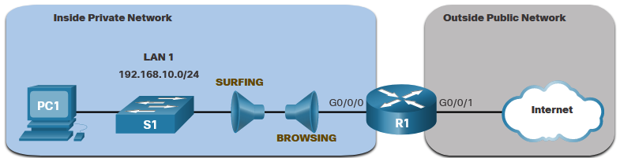
Configure ACLs
Named Extended IPv4 ACL Example
Named extended ACLs are created in essentially the same way that named standard ACLs are created. The topology in the figure is used to demonstrate configuring and applying two named extended IPv4 ACLs to an interface:
SURFING - This will permit inside HTTP and HTTPS traffic to exit to the internet.
BROWSING - This will only permit returning web traffic to the inside hosts while all other traffic exiting the R1 G0/0/0 interface is implicitly denied.

Slide 20
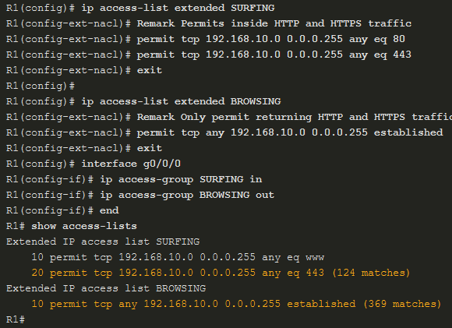
Configure ACLs
Named Extended IPv4 ACL Example (Cont.)
The SURFING ACL permits HTTP and HTTPS traffic from inside users to exit the G0/0/1 interface connected to the internet. Web traffic returning from the internet is permitted back into the inside private network by the BROWSING ACL.
The SURFING ACL is applied inbound and the BROWSING ACL applied outbound on the R1 G0/0/0 interface.
Inside hosts have been accessing the secure web resources from the internet. The show access-lists command is used to verify the ACL statistics.

Slide 21
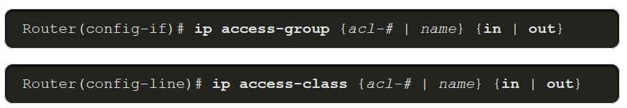
Implement ACLs
Apply an ACL
After creating an ACL, the administrator can apply it in a number of different ways. The following shows the command syntax to apply an ACL to an interface or to the vty lines.

Slide 22
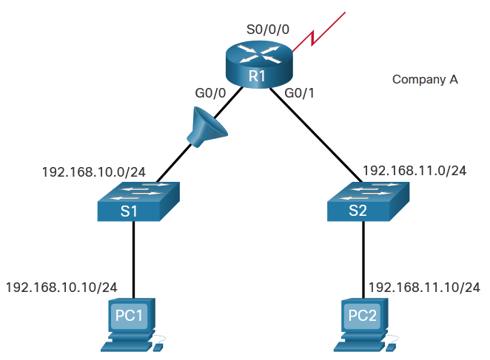
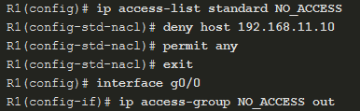
Implement ACLs
Apply an ACL (Cont.)
The figure below shows a named standard ACL applied to outbound traffic.

Slide 23
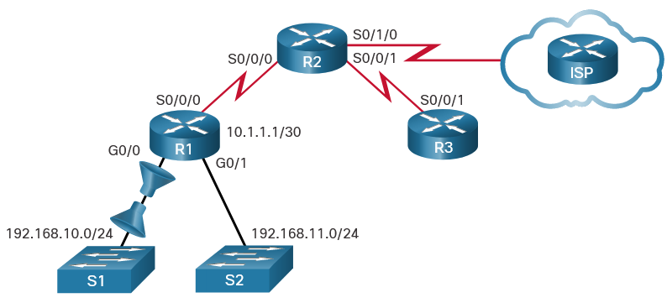
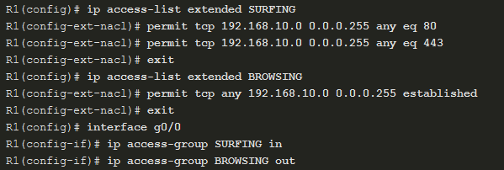
Implement ACLs
Apply an ACL (Cont.)
This figure shows two named extended ACLs. The SURFING ACL is applied to inbound traffic and the BROWSING ACL is applied to outbound traffic.

Slide 24
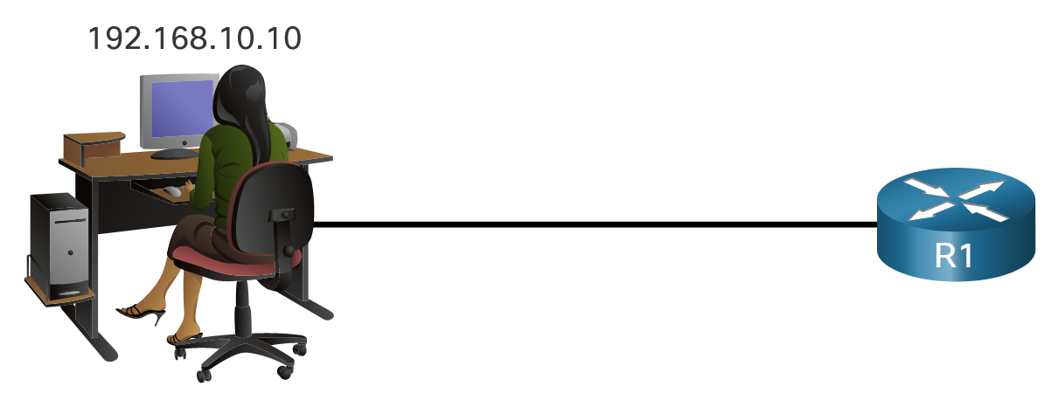
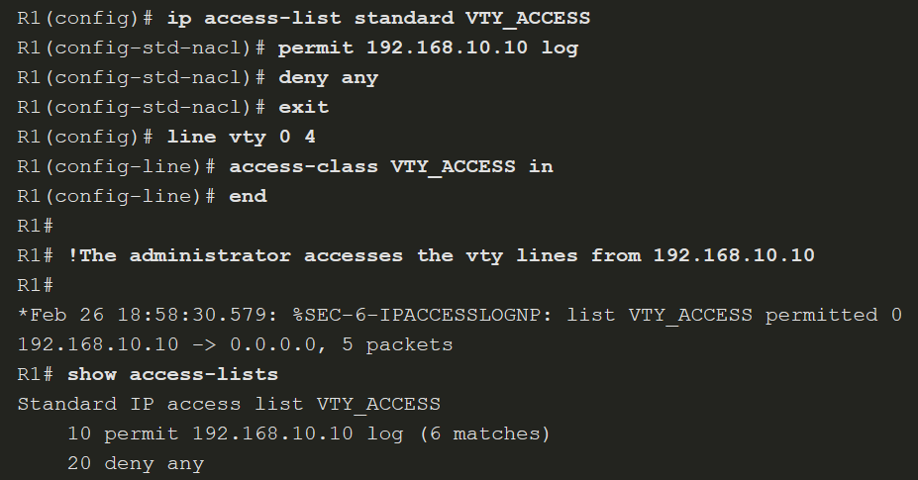
Implement ACLs
Apply an ACL (Cont.)
This example shows an ACL applied to the vty lines.

Slide 25
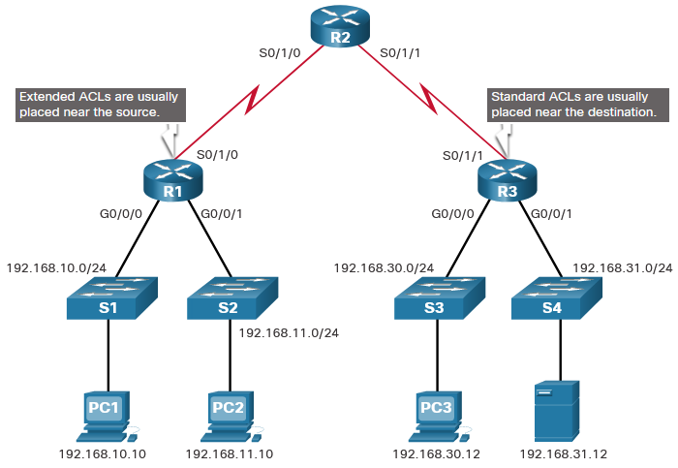
Implement ACLs
Where to Place ACLs
Every ACL should be placed where it is the most efficient.
The figure illustrates where standard and extended ACLs should be located in an enterprise network. Assume the objective is to prevent traffic that originates in the 192.168.10.0/24 network from reaching the 192.168.30.0/24 network.

Slide 26
Implement ACLs
Where to Place ACLs (Cont.)
Placement of the ACL and therefore, the type of ACL used, may also depend on a variety of factors as listed in the table.
Factors Influencing ACL Placement | Explanation
The extent of organizational control | Placement of the ACL can depend on whether or not the organization has control of both the source and destination networks.
Bandwidth of the networks involved | It may be desirable to filter unwanted traffic at the source to prevent transmission of bandwidth-consuming traffic.
Ease of configuration | It may be easier to implement an ACL at the destination, but traffic will use bandwidth unnecessarily. An extended ACL could be used on each router where the traffic originated. This would save bandwidth by filtering the traffic at the source, but it would require creating extended ACLs on multiple routers.

Slide 27
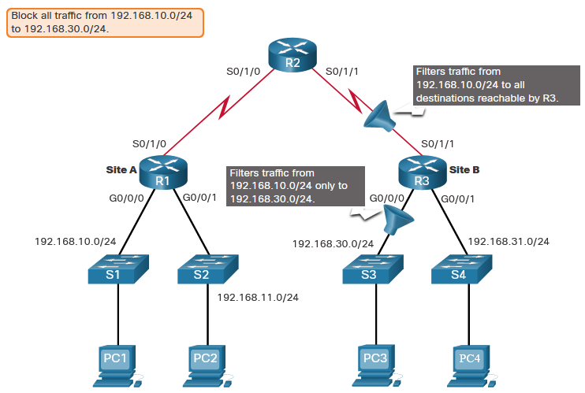
Implement ACLs
Standard ACL Placement Example
Following the guidelines for ACL placement, standard ACLs should be located as close to the destination as possible. In the figure, the administrator wants to prevent traffic originating in the 192.168.10.0/24 network from reaching the 192.168.30.0/24 network.

Slide 28
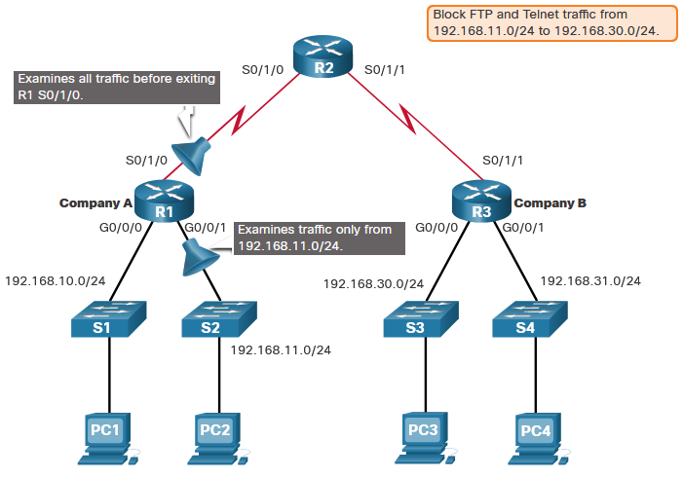
Implement ACLs
Extended ACL Placement Example
Extended ACLs should be located as close to the source as possible. This prevents unwanted traffic from being sent across multiple networks only to be denied when it reaches its destination. However, the organization can only place ACLs on devices that they control. Therefore, the extended ACL placement must be determined in the context of where organizational control extends.
Company A wants to deny Telnet and FTP traffic to Company B’s 192.168.30.0/24 network from their 192.168.11.0/24 network while permitting all other traffic.

Slide 29
Access Control Concepts

Slide 30
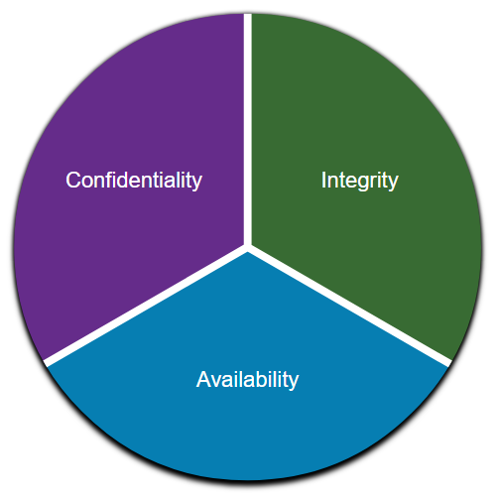
Access Control Communications Security: CIA
Information security deals with protecting information and information systems from unauthorized access, use, disclosure, disruption, modification, or destruction.
CIA Triad
The CIA triad consists of three components of information security:
Confidentiality - Only authorized individuals, entities, or processes can access sensitive information.
Integrity - This refers to the protection of data from unauthorized alteration.
Availability - Authorized users must have uninterrupted access to the network resources and data that they require.

Slide 31
Access Control Access Control Models
An organization must implement proper access controls to protect its network resources, information system resources, and information.
A security analyst should understand the different basic access control models to have a better understanding of how attackers can break the access controls.
The following table lists various types of access control models:
Access Control Models | Description
Discretionary access control (DAC) | This is the least restrictive model and allows users to control access to their data as owners of that data. It may use ACLs or other methods to specify which users or groups of users have access to the information.
Mandatory access control (MAC) | This applies the strictest access control and is used in military or mission critical applications. It assigns security level labels to information and enables users with access based on their security level clearance.

Slide 32
Access Control Access Control Models (Contd.)
Access Control Models | Description
Role-based access control (RBAC) | Access decisions are based on an individual’s roles and responsibilities within the organization. Different roles are assigned security privileges, and individuals are assigned to the RBAC profile for the role. Also known as a type of non-discretionary access control.
Attribute-based access control (ABAC) | It allows access based on attributes of the object to be accessed, the subject accessing the resource, and environmental factors regarding how the object is to be accessed.
Rule-based access control (RBAC) | Network security staff specify sets of rules or conditions that are associated with access to data or systems. These rules may specify permitted or denied IP addresses, or certain protocols and other conditions. Also known as Rule Based RBAC.
Time-based access control (TAC) | It allows access to network resources based on time and day.

Slide 33
AAA Usage and Operation

Slide 34
AAA Usage and Operation AAA Operation
A network must be designed to control who is allowed to connect to it and what they are allowed to do when they are connected. These design requirements are identified in the network security policy.
The policy specifies how network administrators, corporate users, remote users, business partners, and clients access network resources.
The network security policy can also mandate the implementation of an accounting system that tracks who logged in and when and what they did while logged in.
The Authentication, Authorization, and Accounting (AAA) protocol provides the necessary framework to enable scalable access security.

Slide 35
AAA Usage and Operation AAA Operation (Contd.)
The following table lists the three independent security functions provided by the AAA architectural framework:
AAA Component | Description
Authentication | Authentication can be established using username and password combinations, challenge and response questions, token cards, and other methods. AAA authentication provides a centralized way to control access to the network.
Authorization | After the user is authenticated, authorization services determine which resources the user can access and which operations the user is allowed to perform. An example is "User can access host server XYZ using SSH only."
Accounting | Accounting records what the user does, including what is accessed, the amount of time the resource is accessed, and any changes that were made. Accounting keeps track of how network resources are used. An example is "User accessed host server XYZ using SSH for 15 minutes."

Slide 36
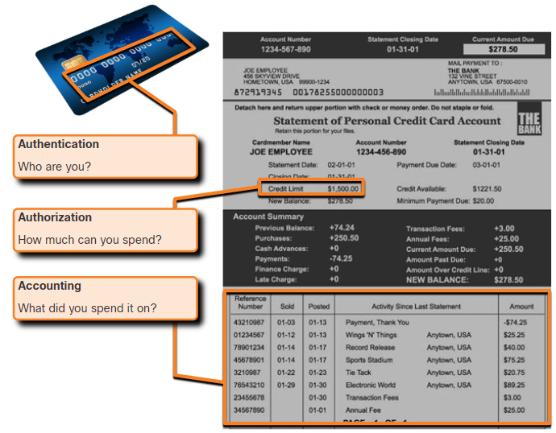
AAA Usage and Operation AAA Operation (Contd.)
This concept is similar to the use of a credit card, as indicated by the figure. The credit card identifies who can use it, how much that user can spend, and keeps account of what items the user spent money on.

Slide 37
AAA Usage and Operation AAA Authentication
AAA Authentication can be used to authenticate users for administrative access or it can be used to authenticate users for remote network access.
Cisco provides two common methods for implementing AAA Services:
Local AAA Authentication
This method is known as self-contained authentication because it authenticates users against locally stored usernames and passwords.
Local AAA is ideal for small networks.

Slide 38

AAA Usage and Operation AAA Authentication (Contd.)
The client establishes a connection with the router.
The AAA router prompts the user for a username and password.
The router authenticated the username and password using the local database and the user is provided access to the network based on information in the local database.

Slide 39
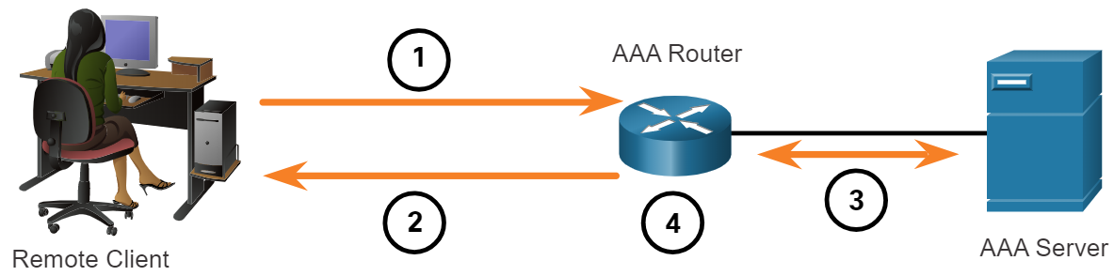
AAA Usage and Operation AAA Authentication (Contd.)
Server-based AAA Authentication
This method authenticates against a central AAA server that contains the usernames and passwords for all users. This is ideal for medium-to-large networks.
The client establishes a connection with the router.
The AAA router prompts the user for a username and password.
The router authenticates the username and password using a AAA server.
The user is provided access to the network based on information in the remote AAA server.

Slide 40
AAA Usage and Operation AAA Authentication (Contd.)
Centralized AAA
Centralized AAA is more scalable and manageable than local AAA authentication, and therefore, it is the preferred AAA implementation.
A centralized AAA system may independently maintain databases for authentication, authorization, and accounting.
It can leverage Active Directory or Lightweight Directory Access Protocol (LDAP) for user authentication and group membership, while maintaining its own authorization and accounting databases.
Devices communicate with the centralized AAA server using either the Remote Authentication Dial-In User Service (RADIUS) or Terminal Access Controller Access Control System (TACACS+) protocols.

Slide 41
AAA Usage and Operation AAA Authentication (Contd.)
The following table lists the differences between the two protocols:
Functions | TACACS+ | RADIUS
Functionality | It separates authentication, authorization, and accounting functions according to the AAA architecture. This allows modularity of the security server implementation. | It combines authentication and authorization but separates accounting, which allows less flexibility in implementation than TACACS+.
Standard | Mostly Cisco supported | Open/RFC standard
Transport | TCP port 49 | UDP ports 1812 and 1813, or 1645 and 1646
Protocol CHAP | Bidirectional challenge and response as used in Challenge Handshake Authentication Protocol (CHAP) | Unidirectional challenge and response from the RADIUS security server to the RADIUS client

Slide 42
AAA Usage and Operation AAA Authentication (Contd.)
Functions | TACACS+ | RADIUS
Confidentiality | Encrypts the entire body of the packet but leaves a standard TACACS+ header. | Encrypts only the password in the access-request packet from the client to the server. The remainder of the packet is unencrypted, leaving the username, authorized services, and accounting unprotected.
Customization | Provides authorization of router commands on a per-user or per-group basis. | Has no option to authorize router commands on a per-user or per-group basis.
Accounting | Limited | Extensive

Slide 43
AAA Usage and Operation AAA Accounting Logs
Centralized AAA also enables the use of the Accounting method.
Accounting records from all devices are sent to centralized repositories, which simplifies auditing of user actions.
AAA Accounting collects and reports usage data in AAA logs. These logs are useful for security auditing.
The collected data might include the start and stop connection times, executed commands, number of packets, and number of bytes.
One widely deployed use of accounting is to combine it with AAA authentication. This helps with managing access to internetworking devices by network administrative staff.

Slide 44
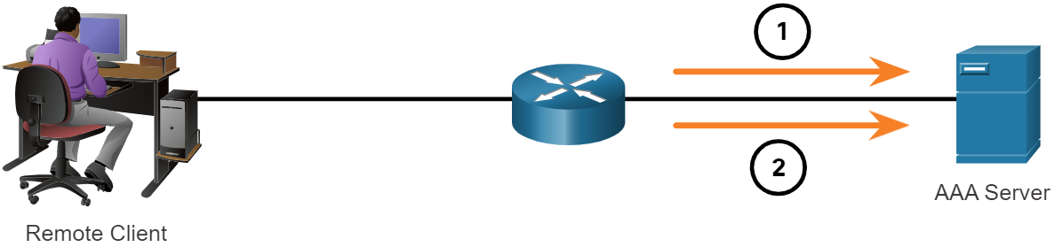
AAA Usage and Operation AAA Accounting Logs (Contd.)
Accounting provides more security than just authentication. The AAA servers keep a detailed log of exactly what the authenticated user does on the device.
This includes all EXEC and configuration commands issued by the user.
When a user has been authenticated, the AAA accounting process generates a start message to begin the accounting process.
When the user finishes, a stop message is recorded and the accounting process ends.

Slide 45
AAA Usage and Operation AAA Accounting Logs (Contd.)
The following table describes the types of accounting information that can be collected:
Types of Accounting Information | Description
Network Accounting | It captures information for all Point-to-Point Protocol (PPP) sessions, including packet and byte counts.
Connection Accounting | It captures information about all outbound connections that are made from the AAA client, such as by SSH.
EXEC Accounting | It captures information about user EXEC terminal sessions on the network access server, including username, date, start and stop times, and the access server IP address.
System Accounting | It captures information about all system-level events.
Command Accounting | It captures information about the EXEC shell commands for a specified privilege level ,as well as the date and time each command was executed, and the user who executed it.
Resource Accounting | It captures 'start' and 'stop' record support for connections that have passed user authentication.

